Slide 1

B2B Collaboration
Usage Model
Health Check Assessment
IBM Automation Application and Integration
Monday March 3rd, 2025

Slide 2
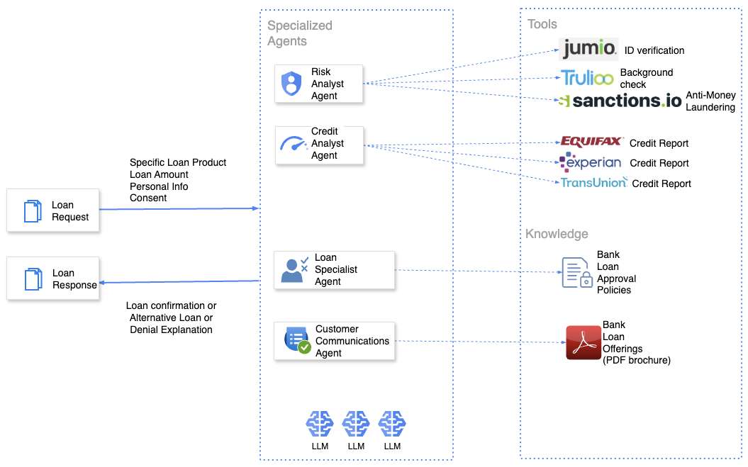
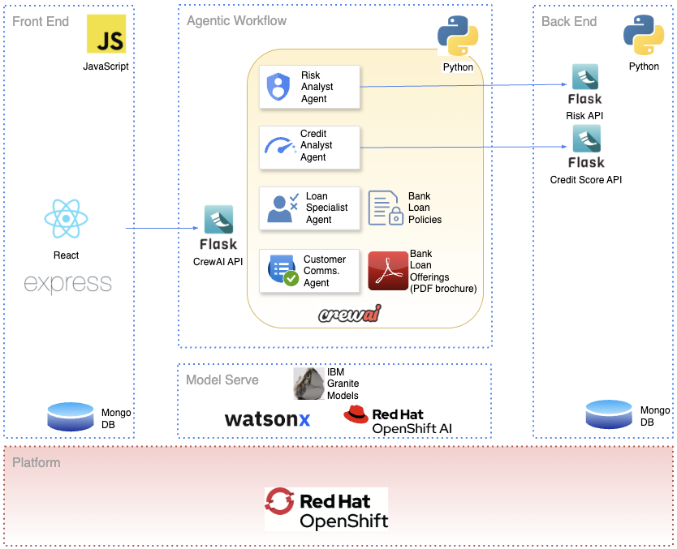
IBM OIC Better Together Data and AI – Retail
Goal : Reimaging the Personal Loan Origination process as an AI Agentic workflow
Initiative Use Case Impact
IBM Developer article published
Source code repo available
Presentation to Red Hat Tech Sales
IBM CSMs in Financial Services using assets
watsonx.orchestrate PMs looking at the implementation

Slide 4
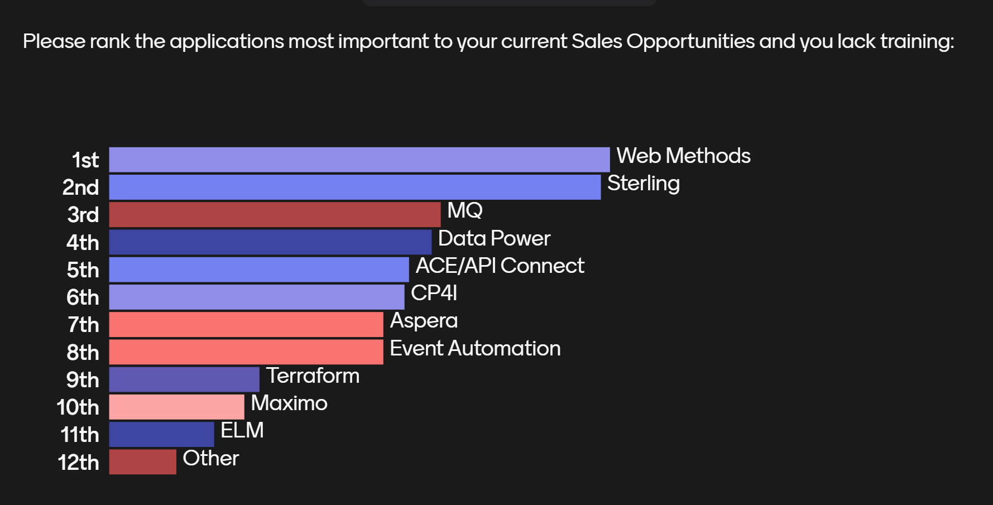

Slide 5


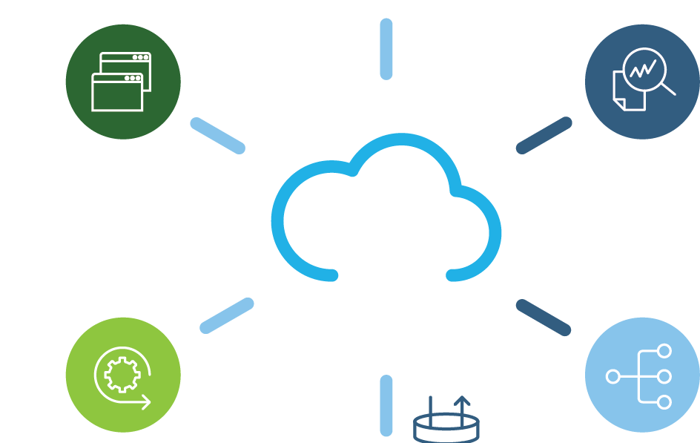

Technical Seller Chatbot Agent LLM
Connectivity
Simplify and agilize client’s interactions, connectivity and collaboration
Automate and digitize B2B Knowledge Bases (101/201 Heath Maps, Qvidian RFPs Repos, Application Knowledge, etc)
Visibility and Insight
Holistic blueprint collaboration
Deliver systematic approach
IBM Automation
Tech Seller
Cadet Deployment Footprint,
Solution
Advisor
(Heatmaps 101, 201)
Discovery
Assessment
Services
LLM
Chatbot
Agent
Technical Training
Quizzes
RFP/RFIs
White Glove
Advisor
RAG/Fine tuned
Application
Logs Files
Qvidian/RFPs
Discovery
Questionnaires
Heath Maps
Data Sources
YourLearning
Level 3/level4
Notes:
IBM Supply Chain Business Network enables you to establish connections with your suppliers to automate and digitize all B2B documents – and leverages IBM cognitive technologies for document correlation to deliver deep visibility into B2B transaction lifecycles and partner performance, so you can see the entire business transaction landscape to provide the business with real time intelligence.

Slide 6
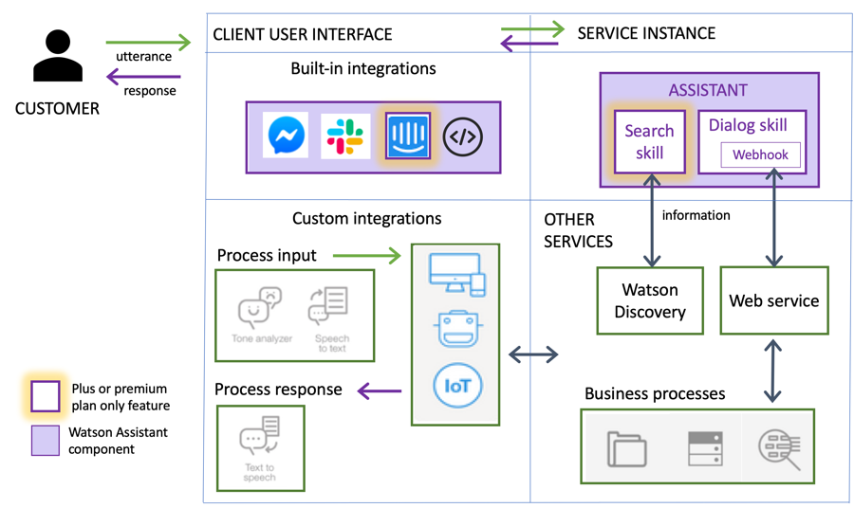
IBM Cloud
Automation Tech Seller
Openshift
AI
TechZone
Ollama VM
Slack

Slide 7

B2B Collaboration
Usage Model
Health Check Assessment
IBM Automation Application and Integration
Monday March 3rd, 2025

Slide 8
Day 1 Agenda
Introductions
Methodology
Next Steps and Timeline
Assessment Results
Adjourn
8
Copyright 2025 IBM. All rights reserved.
8/25/25

Slide 9
Agenda
Introductions
Methodology
Next Steps and Timeline
Assessment Results
Adjourn
9
Copyright 2025 IBM. All rights reserved.
8/25/25

Slide 10

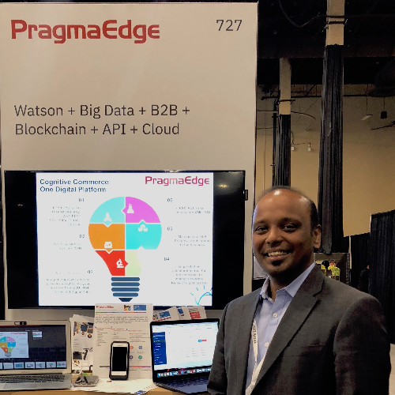

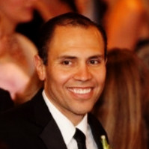

IBM Automation Team
Vedavyas Avula
Chief Architect
Pragma Edge
IBM Premier Partner
248-224-3590 wade@pragmaedge.com
Jake Kyle
Automation Sales Team leader
US National Market
937-475-7559
Jake.kyle@ibm.com
Beth Kraus
Automation Sales Executive
US National Market
732-947-1732
Beth.kraus@ibm.com
Adolfo Loustaunau
Brand Technical Specialist
Americas market
614-817-2777
alousta@us.ibm.com
Gregg Vay
Advisory Integration Technical Specialist, US National Market
724-612-9599
gvay@us.ibm.com

Slide 11
Agenda
Introductions
Methodology
Next Steps and Timeline
Assessment Results
Adjourn
11
Copyright 2025 IBM. All rights reserved.
8/25/25

Slide 12
What we understand on your requirements
I Performance
II Security
III Visibility
IV Business Mission Critical vs Reliability (HA)
V On Boarding Efficiency
VI Cloud and Container Readiness Ecosystem
VII Optimal Architecture
VIII Organization & Housekeeping
IX Team Skills (Training)
X Entitlements Review
Highlights
⁠Improvement/tuning experiences on high-volume platforms.
⁠How to isolate BPs when they are queued in the SFG by an unresponsive CD.
⁠⁠How to suspend the use of a channel without having to delete it. •⁠ ⁠⁠Best practices in SFG and DB2 maintenance procedures. •⁠ ⁠⁠Building CC dashboards for end users. •⁠ ⁠⁠Improving the high availability of SSP and PS.

Slide 13
B2B Health Check Guidelines Threshold
I Performance
II Security
III Visibility
IV Business Mission Critical vs Reliability (HA)
V On Boarding Efficiency
VI Cloud and Container Readiness Ecosystem
VII Optimal Architecture
VIII Organization & Housekeeping
IX Team Skills (Training)
X Entitlements Review
Highlights
Goal: Identify areas of improvements and potential disruption and its solutions
In- Scope: Sterling Prod Footprint Instance
Out-Scope: ERP, Other System of Records
Dependencies and Constraints
10 Assessment Areas
Point System 0 – 4

Slide 14
B2B Collaboration Health Check Assessment Point Score System
0-1 Score Value
Improvement Solution Project Urgently Needed
2 Score Value
Improvement Solution Project Needed in Short Term
3 Score Value
Minor Improvements to implement
4 Score Value
World Class Best Practices Established
Notes:
The Scoring Form uses a 0-4 point range to allocate up to four points for each guideline. We will be completing the Scoring Sheets should review the Information Form each Health Assessment building block being measured and then determine the number of points (0-4) for each guideline that best describes the B2B Collaboration practices being assessed.
The points are recorded in the appropriate box under the assessment guideline on the Scoring Sheet. When each guideline has a 0-4 point score recorded, the average points are computed for each Lean building block and recorded in the lower right corner of the Scoring Sheet. Space is provided for comments and suggestions. These are then totaled up to provide the overall score on the Spider Chart (or Radar Chart) on the Overview page.

Slide 15
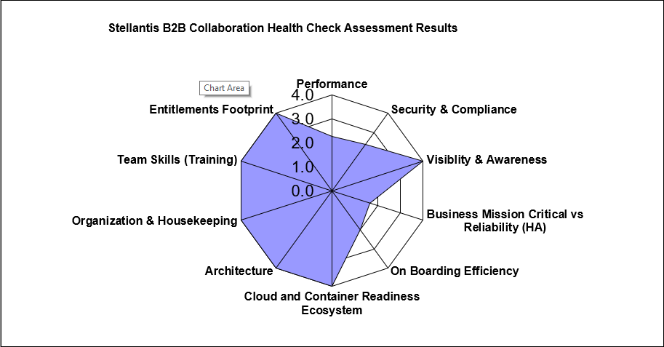
B2B Usage Model Review – Sample Results

Slide 16
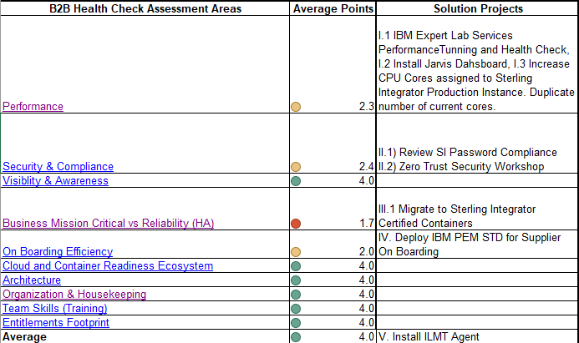
Improvements Solution Projects

Slide 17
ANDALE!!
A = Automated (Straightforward, highlights the automation aspect)
N = Neuronal (Emphasizes the interconnectedness of data and solutions)
D = Data-Driven (Crucial for insights, entitlement, and RFI/RFP support)
A = Adaptive (Highlights the LLM's ability to learn and adjust to user needs)
L = Learning (Reinforces the training and quizzer functionality)
E = Engine (Positions it as a powerful tool).
Notes:
MINI = Maximum Insight, Narrow Input

Slide 18
A = Artificial
N = Neuronal
D = Dynamic Data-Driven in
Y = Your Technical Sales Chatbot Agent.

Slide 19

Notes:
Probably the most important aspect of a successful B2B operation is to continue to grow its use and deliver more value to the business. Best-in-Class companies strive to attain 90% or more automation with their entire trading partner community. Important to point our new capability regarding self service onboarding capability with Partner Engagement Manager. This is an optional service depending on the clients project scope and requirements.

Slide 20
Usage Model Review Process Steps
Step 1
Define Wednesday 02/26/2025 @ 2-3pm EST
Define Goals and Architecture, Organization, Visibility Guidelines
Establish In-Scope and Out-Scope
Step 2
Measure Monday 03/03/2025 @ 8am-4pm CST
Gather Data
Step 3
Analyze Tuesday 03/04/2025 @ 8-3pm CST
Validate Feedback
Identify Improvement Opportunities
Step 4
Improve Tuesday 03/18/2025 @ 2-3pm EST (RoadMap) 03/25/2025 2-3pm (Results)
Establish Solution Projects
Prioritize and Define Roadmap
Assess Input
SI Certified Containers and Live Demo

Slide 22
Agenda
Introductions
Methodology
Next Steps and Timeline
Assessment Results
Adjourn
22
Copyright 2025 IBM. All rights reserved.
8/25/25

Slide 23
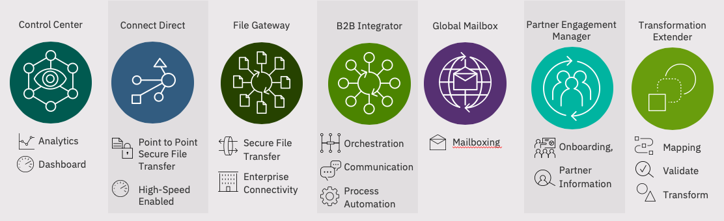
IBM B2B solutions
IBM Secure Proxy
Users
DMZ based application proxy with advanced security features
B2B Cloud
Services
3rd Party
Systems
IBM is the Market Leader
#1 Managed File Transfer Software : IDC
#1 B2B Integration Software: IDC
2/3 of Top 50
Banks
Thousands of Customers

Slide 24
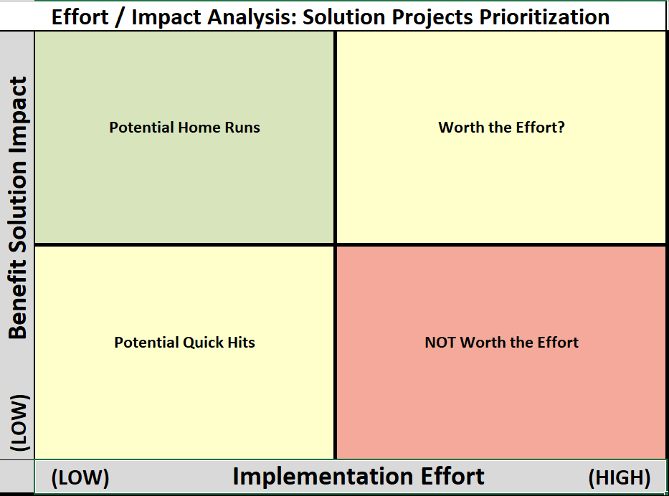
4. PEM STD Implementation
7. Resilience Enhancement: SI Containerization
5. Increase CPU Cores assigned to Sterling Integrator Prod
Password Enhancement, Performance Tunning
Sterling Secure Proxy Implementation
PEM STD Implementation
3. IBM Expert Lab Services Performance Tunning and Health Check
SI Containerization
6. Zero Trust Workshop
ILMT Deployment
2. ILMT Deployment
1. Password Enhancement

Slide 26
Agenda
Introductions
Methodology
Next Steps and Timeline
Assessment Results
Adjourn
26
Copyright 2025 IBM. All rights reserved.
8/25/25

Slide 27
Introductions 8:00am-8:30am
MFT/B2B Assessment Overview 8:30am-9:15am
Lunch 12:00pm-1:00pm
Break 9:45am-10:00am
Architecture Review 10:00am-11:00am
Performance Assessment 11:00am-12:00pm
Data Gathering Tools Review: Jarvis, LLM, Interviews Formats 9:15am-9:45am
Day 1 Agenda
AM
27
Copyright 2025 IBM. All rights reserved.
8/25/25

Slide 28
Organization and Housekeeping 1:00pm-2:00pm
On Boarding Efficiency 2:00pm-3:00pm
Adjourn 4:30pm
Visibility 3:15pm-4:15pm
Recap 4:15pm-4:20pm
Next Steps 4:20-4:30pm
Break 3:00pm-3:15pm
Day 1 Agenda
PM
28
Copyright 2025 IBM. All rights reserved.
8/25/25

Slide 29
Recap and Next Steps 8:00am-8:15am
MFT B2B Cybersecurity 8:15am-9:15am
Lunch 12:00pm-1:00pm
Break 9:45am-10:00am
Cloud and Container Readiness 10:00am-11:00am
High Availability and Resilience 11:00am-12:00pm
Teams Skills and Abilities Assessment 9:15am-9:45am
Day 2 Agenda
AM
29
Copyright 2025 IBM. All rights reserved.
8/25/25

Slide 30
Entitlement Review 1:00pm-2:00pm
Parking Lot Review 2:00pm-3:00pm
Adjourn 4:30pm
Follow Up 3:15pm-4:15pm
Recap 4:15pm-4:20pm
Next Steps 4:20-4:30pm
Break 3:00pm-3:15pm
Day 2 Agenda
PM
30
Copyright 2025 IBM. All rights reserved.
8/25/25

Slide 31
4. PEM STD Implementation
7. Resilience Enhancement: SI Containerization
5. Increase CPU Cores assigned to Sterling Integrator Prod
Password Enhancement, Performance Tunning
Sterling Secure Proxy Implementation
PEM STD Implementation
3. IBM Expert Lab Services Performance Tunning and Health Check
SI Containerization
6. Zero Trust Workshop
ILMT Deployment
2. ILMT Deployment
1. Password Enhancement

Slide 32
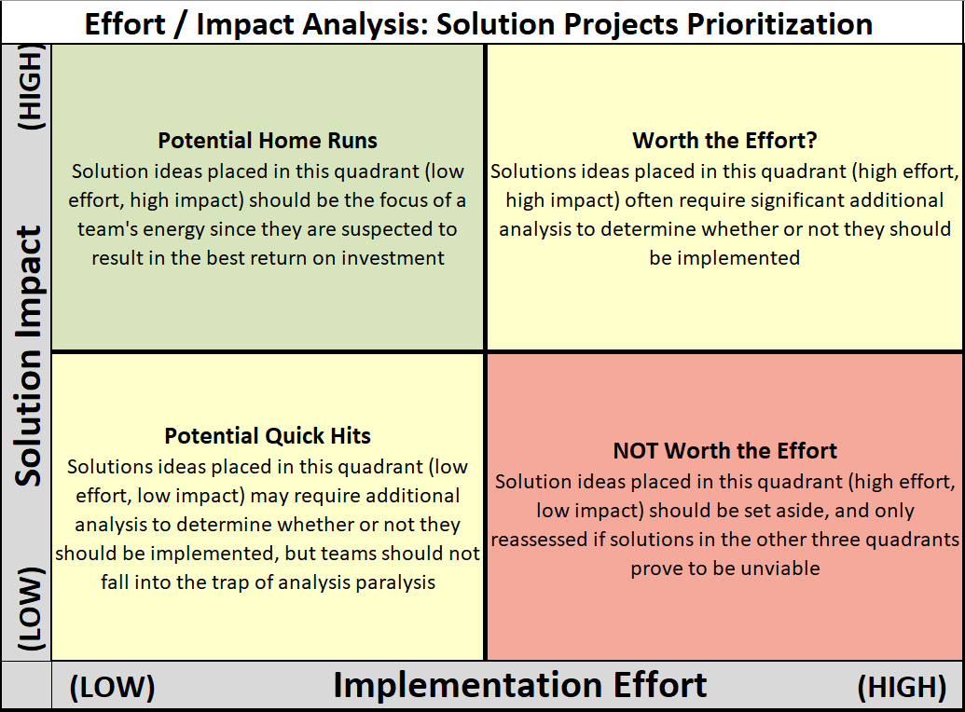

Slide 33
Agenda
Introductions
Methodology
Next Steps and Timeline
Assessment Results
Adjourn
33
Copyright 2025 IBM. All rights reserved.
8/25/25

Slide 34
Let’s put smart to work.

Slide 35


